Slide 1
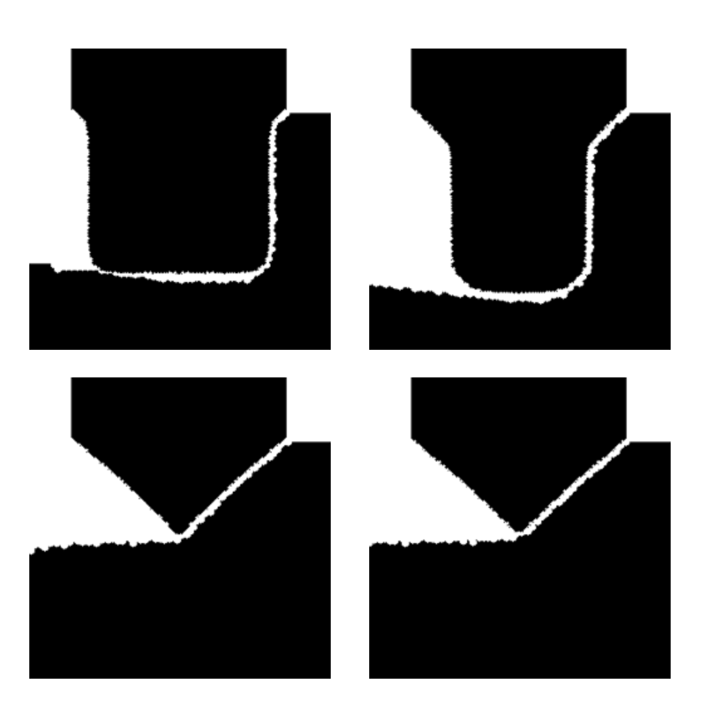

Slide 2
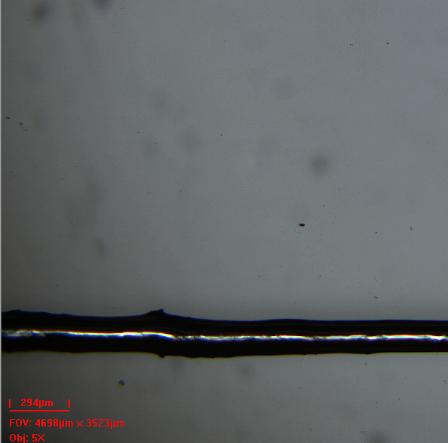
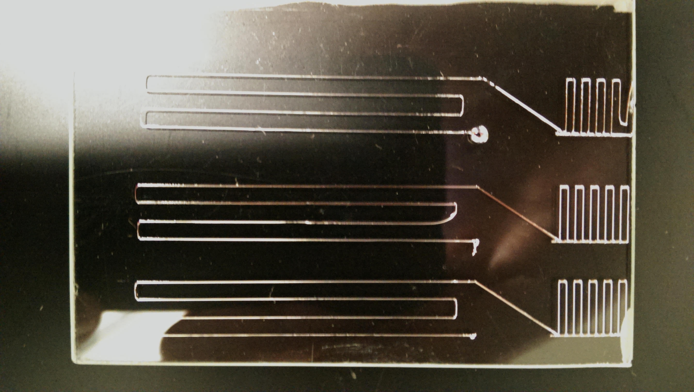

Slide 4
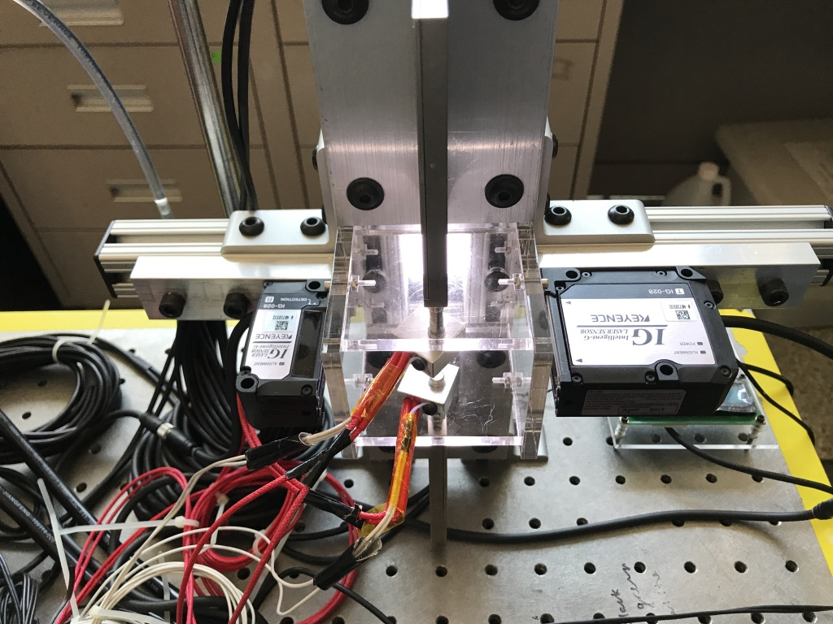








Step 1
Step 2
Step 3
$$L_{f}$$
$$L_{0}$$
$$2R_{mid}(t)$$
$$t=0$$
$$t=t_{M}$$
$$t≤t_{C}$$
Time when plates just start moving
0% - 100% Rise time$t_{M}$: Characteristic time of plate actuation
$t_{C}$: Time of liquid bridge breakup

